Slide 1
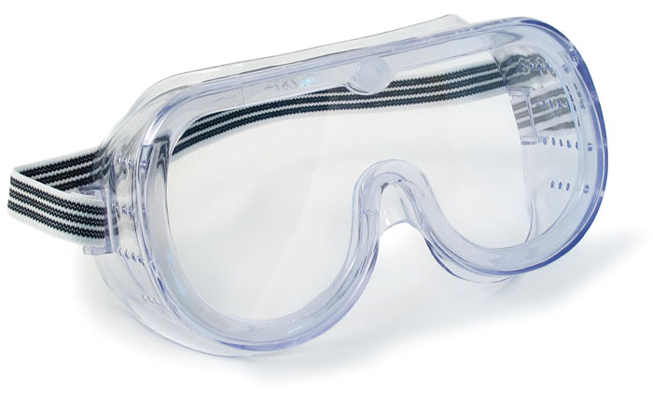
Lab Safety Information
Ventura Community College Chemistry Department
Samantha Freitag

Slide 2
Inform your professor of any sensitives you may have before labs start.
There is greater risk if you are pregnant or planning on becoming pregnant in the duration of the semester, talk to your professor about it.

Slide 3
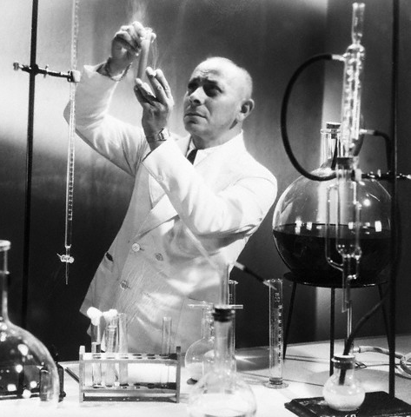
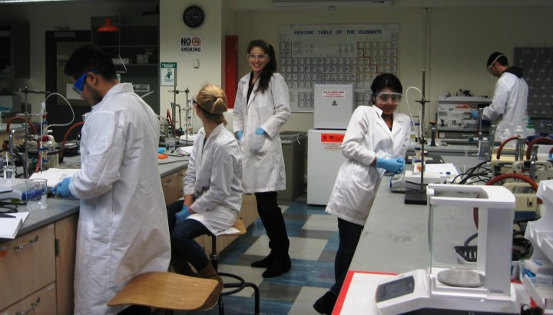
Never work alone in the lab.
You should only be in the laboratory while a professor or lab technician present.

Slide 4
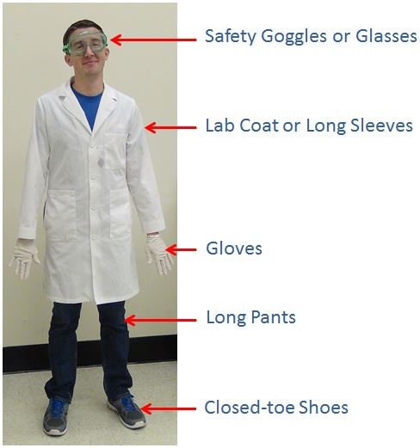
Personal Protective Equipment (PPE)
Hair Pulled Back
Notes:
Student should not be aloud in lab without proper equipment available to them.
Professors’ discretion to enforce

Slide 5
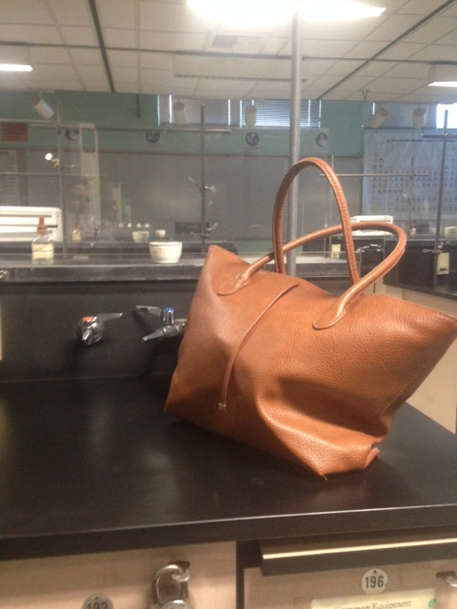
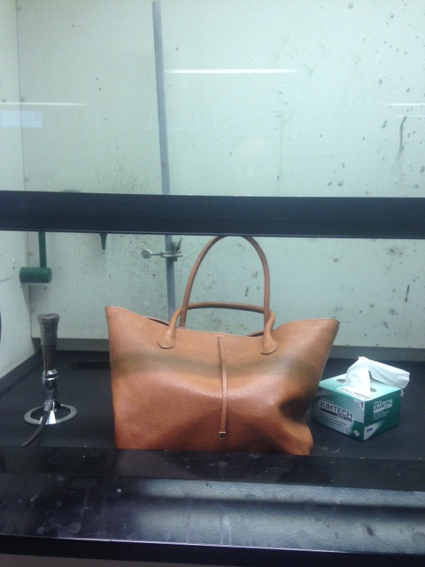
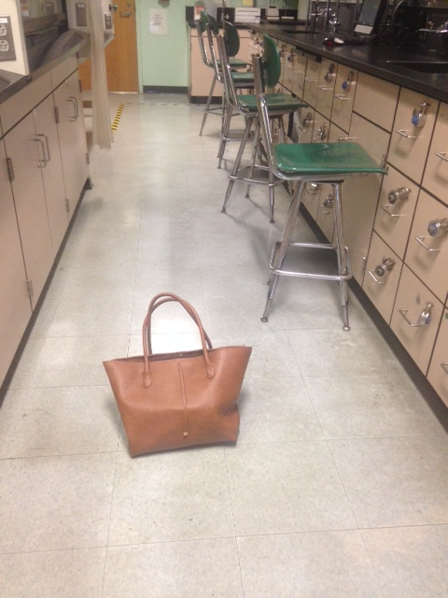
Stow away backpacks and purses in a safe place.
Definitely not in the hood
Not the middle of the floor
Not on the lab bench
Chemicals could be transferred to your bag and you! Or someone is going to trip.

Slide 6
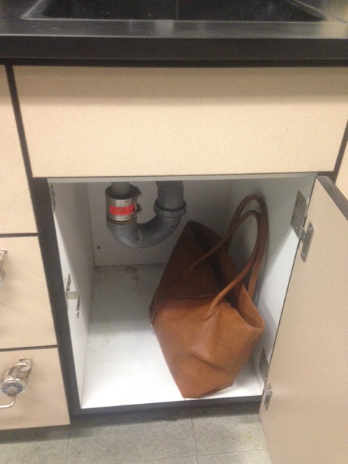
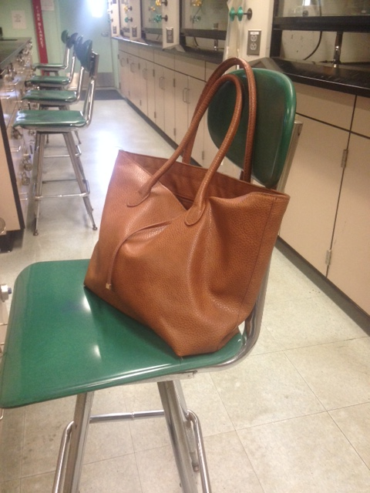
Front of the Classroom
On an empty chair
Under the sink in the cabinet

Slide 7
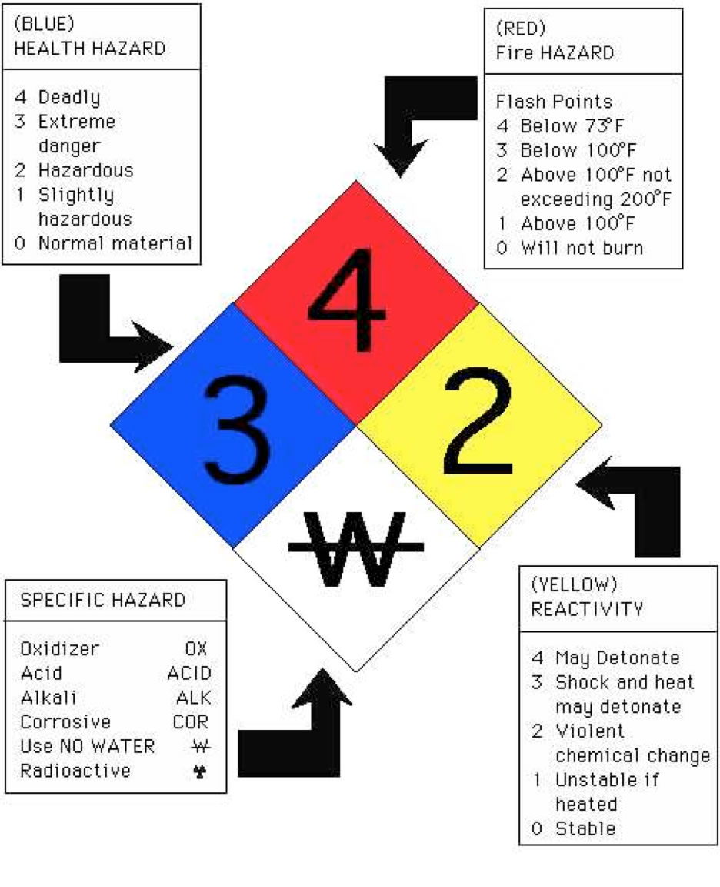
Read chemical bottle labels completely

Slide 9
Do not bring food or drinks into the laboratory
Keep it out of the lab

Slide 10
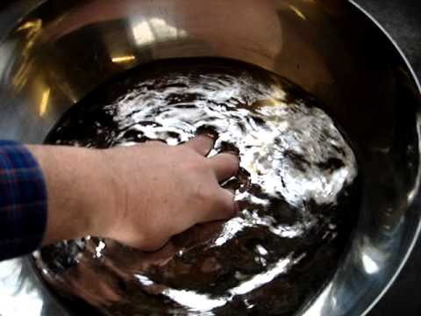
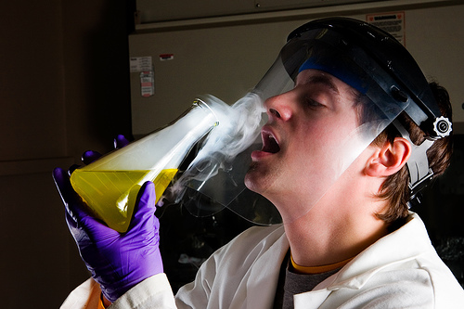
Never taste or touch chemicals with your bare hands

Slide 12
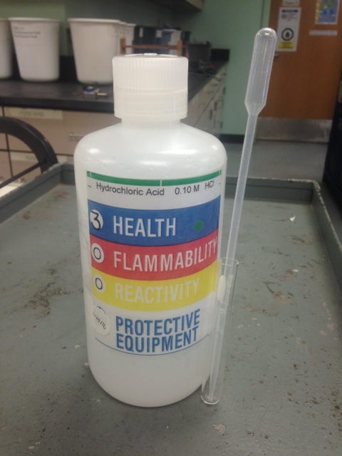
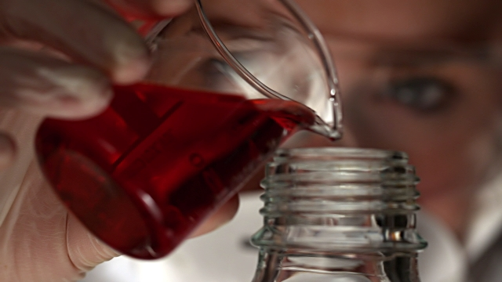
Keep chemical bottles closed when not in use
Do not return chemicals to their bottles once they have been dispensed
WRONG

Slide 13
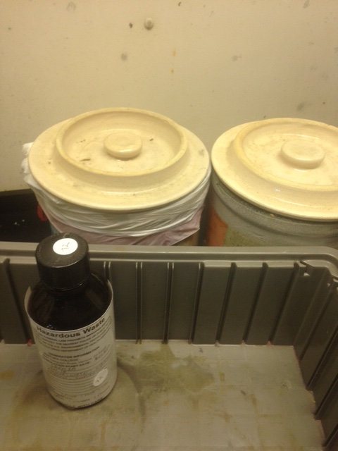
All waste MUST be dispensed in the proper hazardous waste containers located in the hoods
Solid waste
Liquid waste
Make sure to read the label on the bottle!

Slide 14
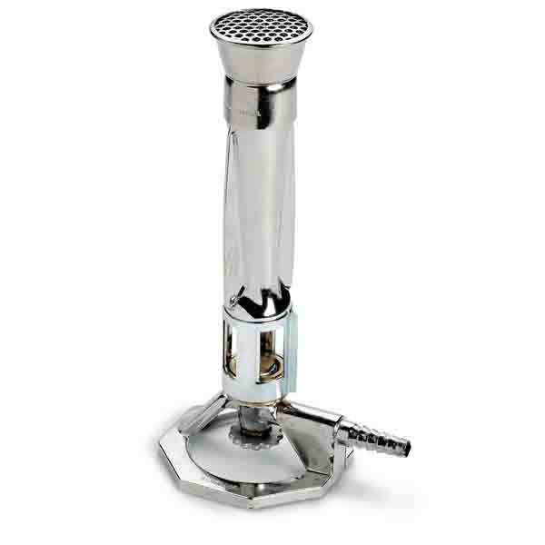
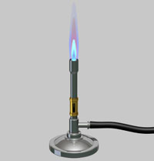
Never touch a Bunsen burner if it is on!
Or if it has been on recently!
It’s hot!
Ensure your hose connections are secure!

Slide 15
Report all accidents to your professor as soon as possible!
You can also tell one of the lab technicians.
(Everything that follows is an accident to report)

Slide 16
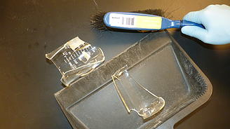
Clean broken glassware with the dust broom, never use your hands!
Tell your professor!
Chemistry glassware is made of Borosilicate glass which is very sharp!
If you break a thermometer tell your professor before attempting to clean it yourself.

Slide 17
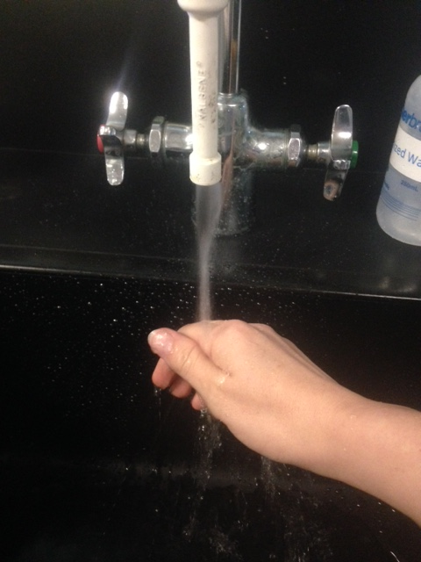
If you spill a chemical on your skin wash the area with water for 15 minutes
Tell your professor!
Always wash your hands before leaving the lab as well

Slide 18
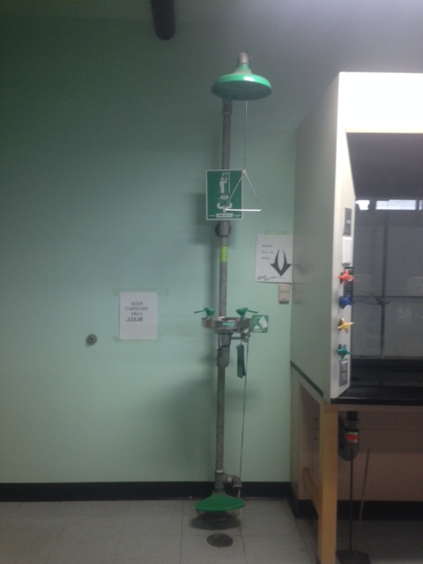
If you spill a chemical on a large portion of your body, remove clothes and use the shower in the back of the lab
This is not the time for modesty!
Pull down on shower handle
Tell your professor!

Slide 19
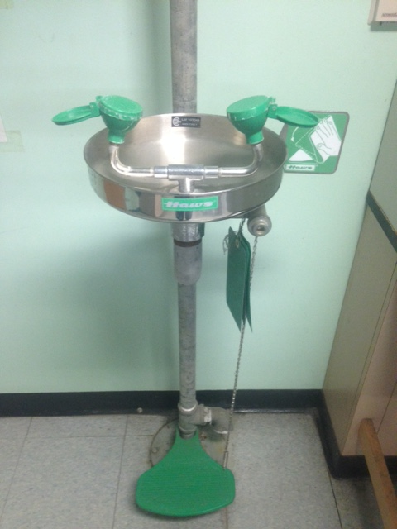
If a chemical gets into your eyes, wash your eyes at one of the eye wash stations located in the back for 15 minutes
Located in the back of the classroom
Tell your professor!

Slide 20
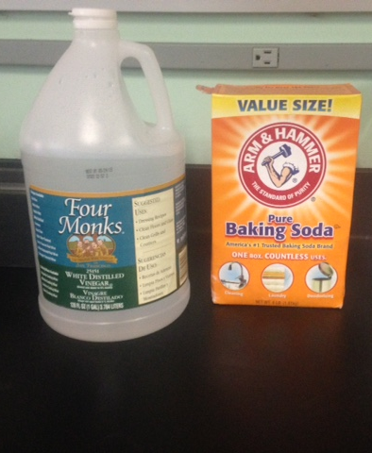
If you spill something use the
baking soda →acid and the vinegar →basic soln’s
Use for basic spills
Use for acid spills
Tell your professor!

Slide 21
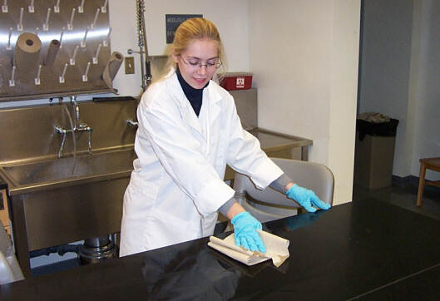
Once the solution is neutralized you can either sweep it up with a dust broom or wipe it down with paper towels.

Slide 22
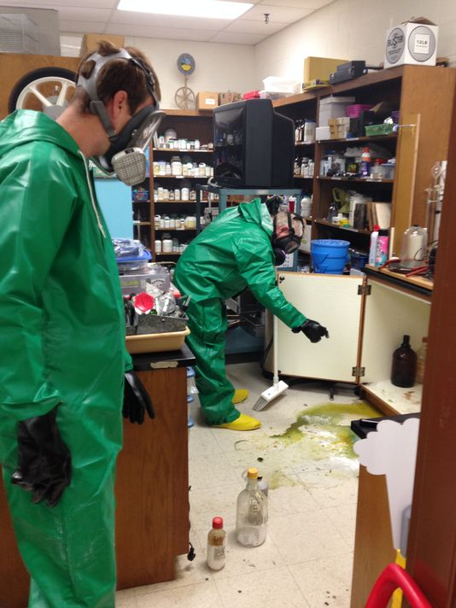
If a major spill occurs call your professor over promptly before attempting to clean it yourself.
Tell your professor!
Tell your professor!

Slide 23
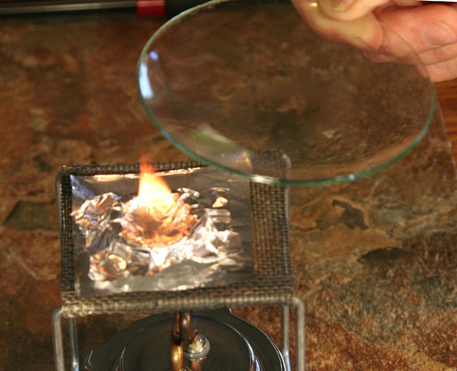
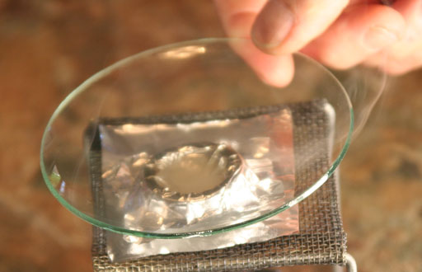
Accidental fire in your glassware? Smother the flame with a watch glass.
Inform your professor or a lab technician.

Slide 24
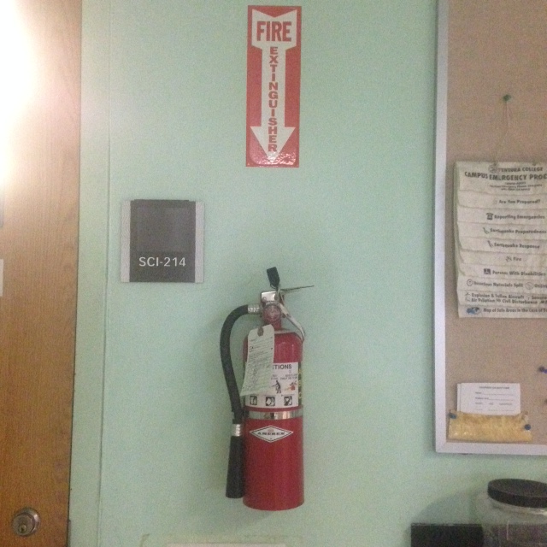
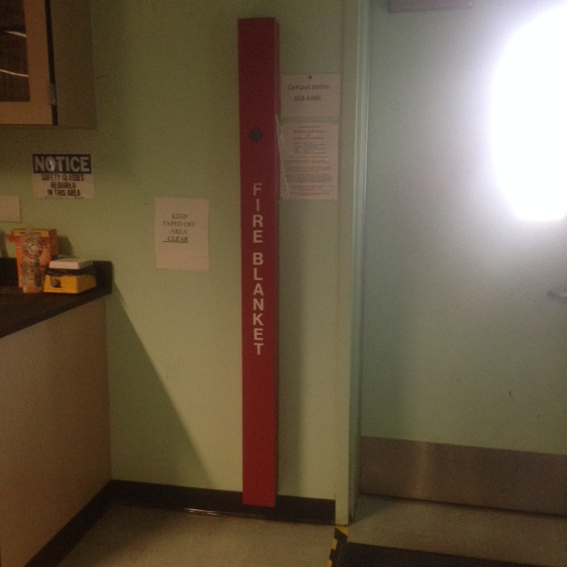
If your clothes or yourself catch on fire, yell fire and someone else from the classroom should go to the fire blanket located in the back of the classroom and roll you in it.
Tell your professor!
Tell your professor!
You can also use the fire extinguisher or shower. Just get the fire out as quickly as possible.

Slide 25
Chemistry Labs are fun but hazardous places!
Be careful and pay attention to these guidelines and your professor.
Let your professor or one of the lab technicians if you have any questions or concerns about your safety.

Slide 26
Video
Part 1
Part 2

